Slide 1
Small Transit Employers: Challenges & Best Practices
14th Annual FTA Drug and Alcohol Program
National Conference
April 2-4, 2019
Robbie L. Sarles, RLS & Associates, Inc.
RLS & Associates, Inc.
Notes:
1

Slide 2
What Are Your Issues?
Prior to the Session Beginning
Write on the 3X5 Card Your Three Biggest Challenges as a Small Employer
Notes:
12
CBD removed from hemp from DEA’s Schedule 1 list, it is now regulated through USDA
CocaCola is looking into making CBD sodas

Slide 3
Objectives
To Present Challenges Commonly Faced by Small Transit Employers
To Present Best Practices for How These Challenges Can Be Met
Note: The Content of This Presentation Does Not Provide Regulatory Requirements or Guidance. Best Practice Examples and Suggested Procedures Are Shown in Blue and Represent the Sole Opinion of the Presenter

Slide 4
Challenges
Limited Staff/Staff Turnover
Program Management
Geographic Service Area
Limited Access to Qualified Service Agents

Slide 5
Challenges
Limited Staff/Staff Turnover
DAPM Initial/Refresher Training
Lack of Cross-Training
Employee Training
Program Management
Geographic Service Area
Limited Access to Qualified Service Agents

Slide 6
Staffing Challenges
Cross Train to the Maximum Extent Possible
Assign Someone to Be the Back-Up DAPM
Provide Training as Necessary for Back-Up
Plan for Expected Absences
Organize and Institutionalize Standard Operating Procedures
Ensure Back-Up is Aware of Document Retention Procedures and Has Access to Pertinent Files
Ensure the Program Continues to Function in Your Absence
Don’t Get Behind

Slide 7
Staffing Challenges
Participate in a Comprehensive DAPM Training Program as Soon as Possible Following Placement in the Position
Transportation Safety Institute Courses
State DOT and State Transit Association-Sponsored Training Programs
On-Line Training Programs
Participate in Refresher Training as Often as Possible
Every 2 to 3 Years Is Recommended (NOT A REQUIREMENT)
After Every Major Regulatory Change

Slide 8
Staffing Challenges
Participate in National, State and Local Conferences Where D&A Sessions Are Presented
FTA Annual Drug & Alcohol Conference
CTAA Expo
National RTAP Conference
TRB Rural and Intercity Bus Conference
Develop and Participate in a Peer Network
Develop a List of Knowledgeable Contacts for Advice, Guidance, and Additional Insight

Slide 9
Staffing Challenges
Enhance Safety-Sensitive Employee Training
Meet Regulatory Requirements
Reasonable Suspicion
Safety-Sensitive Employee Awareness
On-Line Options
Classroom Options

Slide 10
Staffing Challenges
Meet Site Specific Training Needs Often Overlooked
Inform and Educate Employees and Supervisors
Company Policy Specifics
Internal Procedures for Each Testing Category
Roles and Responsibilities
Standard Operating Procedures
Timelines

Slide 11
Staffing Challenges
Introduce Risk Mitigation Procedures
Inform Applicants, New Hires, and Employees
Testing Requirements
Practical Realities of Today’s World
Avoiding a Positive Test
Medical Marijuana
Recreational Marijuana
Opioid Pain Medication Misuse
Avoiding a Safety Risk Determination

Slide 12
Challenges
Limited Staff/Staff Turnover
Program Management
Competition for Scarce Time and Resources
No Written Standard Operating Procedures
Policy Consistency
Geographic Service Area
Limited Access to Qualified Service Agents

Slide 13
Program Management Challenges
Establish D&A Program as a Priority
Re-Establish Importance and Relevancy as a Critical Safety Program: Avoid Complacency
Designate Dedicated Time and Resources for Critical Program Management Activities
Random Selection and Scheduling
Recordkeeping/Filing
MIS Report Preparation
Service Agent Oversight
Policy and Procure Updates
Employee Training

Slide 14
Program Management Challenges
Keep Up-to Date
Regulatory Changes
Interpretations
Best Practices/Networking Opportunities
Resources
DAPM Training

Slide 15
Program Management Challenges
Peruse Official Websites
FTA
ODAPC
Implementation Guidelines
Subscribe to FTA Drug and Alcohol Regulation Updates Newsletters
Read as Soon as Published!
Create Electronic Reference Library of FTA and ODAPC Publications
Consult When Questions Arise
Don’t Reinvent the Wheel

Slide 16
Program Management Challenges
Create Written Standard Operating Procedures
Simple Step-By-Step Procedures
Checklists
Forms (with Instructions)
File Structure
Timelines/Schedule
File Organization

Slide 17
Program Management Challenges
Avoid Separation of Responsibilities to Different Departments and Locations, if Possible
Develop Procedures for Necessary Information Sharing Between Departments (i.e. HR and Transit)
Communication and Confidentiality
Define Roles and Responsibility for Compliance
Designate One DAPM as Ultimately Responsible
Ensure Transit DAPM Provides Input/Defines Policy and Procedures Impacting Transit Compliance
File Location: Avoid Decentralized Recordkeeping
Preferably One Repository for All D&A Files

Slide 18
Program Management Challenges
Revisit Policy Assumptions—Inconsistent Application
Zero Tolerance vs Second Chance
Philosophical Changes
Societal Expectations
Practical Reality
Safety
Risk Management
Hire/Fire/Rehire Practices

Slide 19
Program Management Challenges
Schedule Random Tests with Caution to Ensure Unpredictable and No Advance Warning Is Provided
Schedule Substitute Drivers in the Same Manner They Would Be Scheduled for Other Unexpected Absences
Not Exclusively for Testing
Avoid a Pattern or Practice That Indicates When Tests Will Be Conducted
Increase the Number of Random Tests in a Period to Inform Employees That Additional Tests Can Be Performed Even if Testing Rate Has Been Met

Slide 20
Program Management Challenges
Schedule Random Test During All Times Safety-Sensitive Functions Are Performed—Even When Operationally Inconvenient

Slide 21
Program Management Challenges
If Mobile Collectors Are Used, Actively Manage the Manner of Service Delivery
Avoid Predictability
Timing of Tests as a Function of Distance from Mobile Collector’s Home Base
Scheduling of Tests Based on Mobile Collector’s Trip Circuit
Group Testing for Mobile Collector’s Convenience and Profitability
“Announcement of Testing” Associated with the On-Site Presence of Mobile Collector’s Vehicle

Slide 22
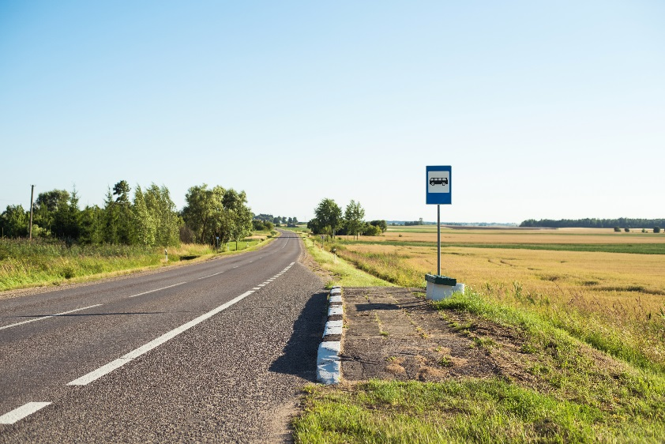
Challenges
Limited Staff/Staff Turnover
Program Management
Geographic Service Area
Limited Management Oversight in Remote Areas
Limited Access to Qualified Service Agents

Slide 23
Geographic Area Challenges
Establish Decision Making Protocol for Remote Accidents
Dispatch Supervisor to Scene if Possible
If Not Possible and Operator is Not Injured
Require Operator to Immediately Report to Management/Dispatcher After Securing Situation
Establish Procedures for Dispatcher to Interview Operator to Ascertain Relevant Details of the Accident/Send Pictures if Possible
Procedures for Dispatcher to Interview/Verify Details with On-Site Law Enforcement/Witnesses
Determine if Post-Accident Testing Thresholds Have Been Met

Slide 24
Geographic Area Challenges
If Operator is Injured
Dispatch Supervisor to Scene Immediately
Do Not Delay Operator Access to Medical Treatment
Develop Procedures for Obtaining Information
Local Law Enforcement at the Scene
Medical Treatment Facility
Determine if Post-Accident Testing Thresholds Have Been Met
Arrange for Test at Medical Facility As Appropriate

Slide 25
Geographic Area Challenges
Establish Decision Making Protocols for Reasonable Suspicion Testing in Remote Locations with No Supervisor Coverage
Investigate All Complaints
Send Trained Supervisor Immediately to Location
Verify Identity of Witness and Interview
If On-Board Cameras, View if Real Time Access
View Witness Provided Real Time Video Footage
If Possible Concern Exists, Instruct Driver to Cease Performing Safety-Sensitive Function
Supervisor Conducts Reasonable Suspicion Assessment When Arrives On-Site

Slide 26
Geographic Area Challenges
Establish Procedures for Accessing Remote Testing Locations
Assess Total Service Coverage Area to Determine Proximity (e.g. Drive Time) to Collection Sites
Identify Areas Where There are Gaps (More than 60-120 Minutes)
Identify Alternative Collection Sites to Fill Gaps
TPA Assistance
Other Transit Systems/DOT-Covered Employers in the Area
Develop Accounts with Alternative Sites

Slide 27
Challenges
Limited Staff/Staff Turnover
Program Management
Geographic Service Area
Limited Management Oversight in Remote Areas
Limited Access to Qualified Service Agents
Limited Collection Site Options
Limited Days and Hours
Minimal Competition
to Drive Quality
Limited SAP Options

Slide 28
Service Agent Challenges
Develop Procedures for Obtaining Collection Services During Non-Business Hours
Establish Positive Relationship with Management and Staff
Negotiate Individual Instances of After Hours Collections Rather Than Change of Office Hours
Contract with Individual Collectors, if Possible
Contract with Other Off-Duty Medical Professionals
Contract with Other Non-Medical Agencies/Firms
Local Social Service Agencies
Local Public/Governmental Entities
Conduct In-House Collection Services

Slide 29
Service Agent Challenges
Promote Quality of Collection Site Services When Competition Is Limited
Establish Mutually Beneficial Partnerships
Access to DOT/FTA Resources
ODAPC Mock Collection Video
Publications/Checklists
Ensure All Collectors/BATs are on Appropriate ODAPC List Serve
Quality, Informed, Non-Punitive Feedback

Slide 30
Service Agent Challenges
Investigate Irregular Collection Events and Cancelled Tests
Conduct Oversight Activities
CCF/ATF Review
Annual Inspections
Mock Collections

Slide 31
Service Agent Challenges
Review All Chain of Custody and Control Forms (CCF) and All Alcohol Testing Forms (ATF)
Review as Tests Are Conducted
Seek to Correct All Errors Found Even if There Is No Cause for the Test to be Cancelled
Notes:
12

Slide 32
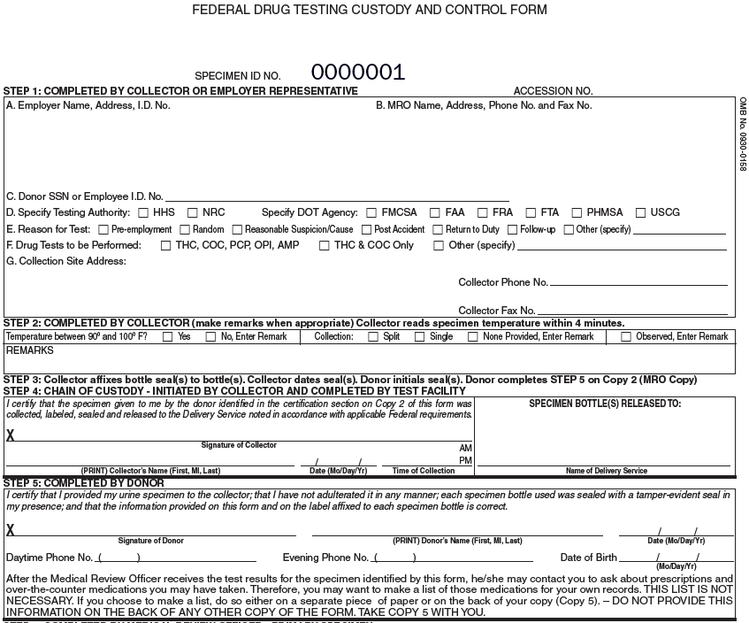
Round 1
Axon County Transit Authority
742 Evergreen Ter., Springfield, CA 12345
Dr. Julius M. Hibbert, M.D.
1709 Broderick St., San Francisco, CA 94115
Office.520.867.53509|Fax.520.606.0842
123-45-6789
I.C.U.P. Services
125 Troy St., Springfield, CA 12345
455-788-1222
455-788-1223
Courier
Edith V. Shain
8 01 12 9:30
Dale A. Gribble
Dale A. Gribble
12 25 53
455 777 9311
8 01 12

Slide 33
Round 1 - Answers
Axon County Transit Authority
742 Evergreen Ter., Springfield, CA 12345
Dr. Julius M. Hibbert, M.D.
1709 Broderick St., San Francisco, CA 94115
Office.520.867.53509|Fax.520.606.0842
123-45-6789
I.C.U.P. Services
125 Troy St., Springfield, CA 12345
455-788-1222
455-788-1223
Courier
Edith V. Shain
8 01 12 9:30
Dale A. Gribble
Dale A. Gribble
12 25 53
455 777 9311
8 01 12

Slide 34
Round 2
Medical Review Services, Inc.
1709 Broderick St., San Francisco, CA 94115
Dr. Julius M. Hibbert, M.D.
Medical Review Services, Inc.
1709 Broderick St., San Francisco, CA 94115
Office.520.867.53509|Fax.520.606.0842
123-45-6789
I.C.U.P. Services
125 Troy St., Springfield, CA 12345
455-788-1222
455-788-1223
PickUps Courier Co.
8 01 12 9:30
Dale A. Gribble
Dale A. Gribble
8 01 12
455 777 9311
455 777 9311
12 25 53

Slide 35
Round 2 - Answers
Medical Review Services, Inc.
1709 Broderick St., San Francisco, CA 94115
Dr. Julius M. Hibbert, M.D.
Medical Review Services, Inc.
1709 Broderick St., San Francisco, CA 94115
Office.520.867.53509|Fax.520.606.0842
123-45-6789
I.C.U.P. Services
125 Troy St., Springfield, CA 12345
455-788-1222
455-788-1223
PickUps Courier Co.
8 01 12 9:30
Dale A. Gribble
Dale A. Gribble
8 01 12
455 777 9311
455 777 9311
12 25 53

Slide 36
ATF REVIEW
Notes:
12

Slide 37
Service Agent Challenges
At a Minimum Conduct a Basic Level of Oversight
Telephone Conversation with Collection Site Management
Hours
Training
Appointments, Wait Times, Special Requests
Result Reporting Procedures/Confidentiality
Contact Information
Desk/Records Review
ATF Review
CCF Review
EBT Calibration Log
Training Credentials
Notes:
12

Slide 38
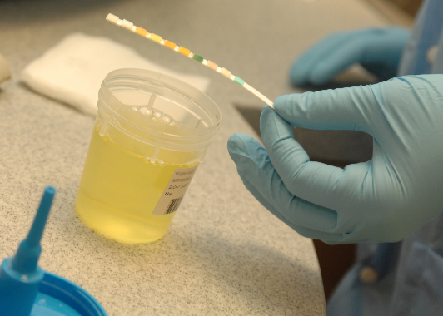
Service Agent Challenges
Preferably Perform On-Site Monitoring Annually/Biannually
Basic “Mock Collection”
Collection Only with No Interview
Provide Advanced Notice
Conduct as Part of Actual Collection (e.g., DAPM Random Test)
Perform “Mock Collection” PLUS
Follow-up Interview as Baseline or in Response to Issues
Notes:
12

Slide 39
Service Agent Challenges
Conduct Quality Mock Collection
Provides an Understanding of the Technician’s Knowledge and the Site’s Operating Procedures
Provides Assessment of Compliance with 49 CFR Part 40
Provides Opportunity to Inspect
Equipment, Facility, Security
Training Certifications and Credentials

Slide 40
Service Agent Challenges
Prepare to Conduct a Mock Audit
Office of Drug and Alcohol Policy & Compliance (ODAPC) (www.dot.gov/odapc/)
DOT’s Mock Collection Video
DOT’s 10 Steps to Collection Site Security and Integrity
Notes:
12

Slide 41
Service Agent Challenges
Resources:
ODAPC “Mock Collection” Video: https://www.transportation.gov/odapc/dot-mock-collection-instructional-video
ODAPC “10 Steps to Collection Site Security” Video: https://www.transportation.gov/odapc/collection-site-security-integrity-video
ODAPC – Employer Brochure “Monitoring Collection Sites:” https://www.transportation.gov/odapc/employer_brochure
ATF Review Checklist: https://transit-safety.fta.dot.gov/DrugAndAlcohol/Tools/DAPMForms/Checklists/Alcohol%20Testing%20Form%20Review%20Checklist.docx
CCF Review Checklist: https://transit-safety.fta.dot.gov/DrugAndAlcohol/Tools/DAPMForms/Checklists/Drug%20Testing%20Custody%20and%20Control%20Form%20Review%20Checklist.docx
Notes:
12

Slide 42
Service Agent Challenges
Interview Medical Review Officers
MRO and MRO Staff Protocols
Methods of Communication
Test Results
Retest Requirements
Other Issues
Procedures for Identifying and Mitigating Potential Safety Risks
Communicate Preferences/Direction if Inconsistent with Agency Philosophy

Slide 43
Service Agent Challenges
Ensure Individuals Performing Substance Abuse Professional Functions Are Qualified
Credentials
Consult ODAPC’s List
Proximity
At Least Two

Slide 44
Questions?
EMAIL - RLS@RLSANDASSOC.COM
RLS & Associates, Inc.
3131 South Dixie Highway, Suite 545
Dayton, Ohio 45439
(937)299-5007

